Slide 1
Leeds Beckett University
Cloud Computing Development
Dr Anatoliy Gorbenko
E-mail: A.Gorbenko@leedsbeckett.ac.uk Office: CAE118
Kiran Voderhobli
E-mail: k.voderhobli@leedsbeckett.ac.uk Office: CAE228

Slide 2
Cloud Computing Development
Lecture: Evolution of Distributed Computer Systems
Anatoliy Gorbenko
Kiran Voderhobli

Slide 3
Lecture Agenda
Utility Computing
Cluster Computing
Grid Computing
Cloud Computing
Trends of distributed computing

Slide 4
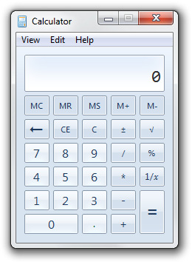
What is Computing
… any goal-oriented activity requiring, benefiting from, or creating computers (HW/SW/Networks).
Designing and building hardware and software systems for a wide range of purposes
Doing any activity using computers
Processing, structuring, and managing various kinds of information
Making computer systems behave intelligently
Creating and using communications and entertainment media
…

Slide 5

The 5th Utility
Water
Electricity
Natural gas
Telephone network
Computing is being transformed to a model consisting of services that are commoditized and delivered in a manner similar to traditional utilities

Slide 6
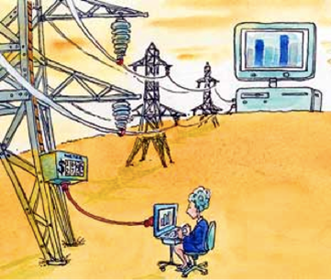
Utility Computing
Offers computing resources as a metered service
Provides the basic level of computing service that is considered essential to meet the everyday needs
Users access services based on their requirements without regard to where the services are hosted or how they are delivered

Slide 7
Utility Computing
As of now, computer networks are still in their infancy, but as they grow up and become sophisticated, we will probably see the spread of computer utilities which, like present electric and telephone utilities, will service individual homes and offices across the country.
… computing may someday be organized as a public utility just as the telephone system is a public utility... The computer utility could become the basis of a new and important industry.
− John McCarthy (a professor of MIT) 1961
− Leonard Kleinrock (one of the chief scientists of the original ARPANET project) 1969

Slide 8
Paradigms
Attributes:
Accessibility
Manageability
Autonomic
Performance
Scalability
Availability
QoS
SLA
…
Utility Computing
Cluster Computing
Grid Computing
Cloud Computing
Node/Fog Computing
…

Slide 9
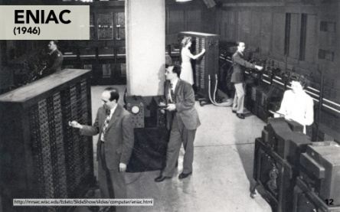
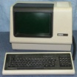
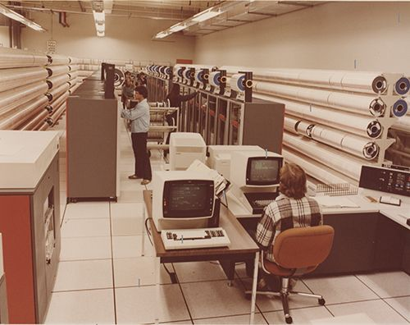
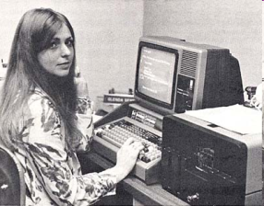
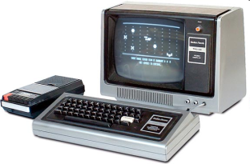
History
1946 – Mainframe «ENIAC» (Electronic Numerical Integrator And Computer)
begin. of 1960x – Multi-terminal Mainframes (VAX)
1965 – the first mini-computer PDP-8 (Digital Equipment)
1969 – ARPANet (Mainframe 2 Mainframe)
begin. of 1970x – first global networks (X.25, IBM SNA )
begin. of 1970x – first CHIPs
1974 – first mini-computers based on CPU Intel-8008
1980 – Ethernet LAN (10Mb/s)
1983 – Arpanet (<1000 ЭВМ) => Internet + Milnet
1983 – TCP/IP stack of protocols
1985 – first PCs

Slide 10
Computers Food Chain
Wildlife
Computers
Workstation
PC
Mini Computer
Mainframe
Distributed computing
Workstation
Mainframe
PC
Mini Computer

Slide 11
Distributed Computing
A computer system in which several interconnected computers share the computing tasks assigned to the system
Cluster computing
Grid computing
Cloud computing
Fog computing

Slide 12
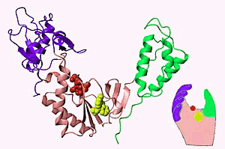



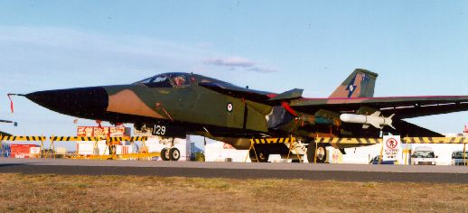
Demand for Computing Power
Solving grand challenge applications using computer modeling, simulation and analysis
Aerospace
Life Sciences
Internet &
Ecommerce
CAD/CAM
Digital Biology
Military Applications

Slide 13
How to Run Applications Faster
There are 3 ways to improve performance:
Work Harder
Work Smarter
Get Help
Computer analogy
Using faster hardware
Using optimized algorithms and techniques to solve computational tasks
Using multiple computers to solve a particular task

Slide 14
Towards Commodity Computing
Performance trends in 1980s and before (Scale UP)
Computer performance was best improved by creating faster and more efficient processors
Trend of modern computing since the early 1990s (Scale OUT)
From specialized supercomputing platforms
To inexpensive, general purpose systems consisting of loosely coupled components built up from single or multiprocessor PCs or workstations
Low-cost commodity supercomputing
Linking together two or more computers to jointly solve some computational problem
Providing high performance computational facilities for large-scale and grand-challenge applications

Slide 15
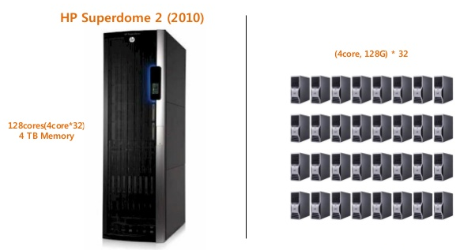
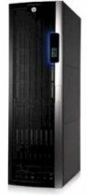
Scaling UP vs Scaling OUT
Out
+
+
Up
+

Slide 16
Distributed Computing
A cluster is a type of parallel and distributed system, which consists of a collection of inter-connected stand-alone computers working together as a single integrated computing resource
Cluster computing
Grid computing
Cloud computing

Slide 17
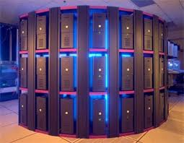
The Cluster
A Node
A single or multiprocessor system with memory, I/O facilities, & OS
A Cluster:
Generally two or more computers (nodes) connected together
In a single cabinet, or physically separated & connected via a LAN
Appear as a single system to users and applications
Provide a cost-effective way to gain features and benefits
Enabled for Parallel Computing

Slide 18
Parallel Computing
Parallel Computing
A form of computation in which many calculations are carried out simultaneously
Large problems can often be divided into smaller ones, which are then solved concurrently ("in parallel")
Parallel programming model
A set of software technologies to express parallel algorithms and match applications with the underlying parallel systems
Advantages
Cost efficient
High performance
Improve Utilization

Slide 19
Massage Passing Interface (MPI)
Start
Two Basic Models of Parallel Computing
Shared memory model (Memory can be simultaneously accessed by multiple process with an intent to provide communication among them or avoid redundant copies)
Distributed memory model (each processor has its own private memory; computational tasks can only operate on local data, and if remote data is required, the computational task must communicate with one or more remote processors)
MPI
Distributed memory
A specification that allows computers communicate with each other
Use Message Passing to do synchronization
Initialization
Process 1
Process 2
Process 3
▪ ▪ ▪ ▪ ▪ ▪ ▪
Process N
Communication
Communication
Communication
Finalization
Complete

Slide 20
Distributed Computing
Distributed computing infrastructure for advanced science and engineering introduced to coordinate resource sharing and problem solving in dynamic, multi-institutional virtual organization (VO)
Cluster computing
Grid computing
Cloud computing

Slide 21
Grid Environments
Virtual Organization (VO)
A set of individuals and/or institutions defined by such sharing rules form (what is shared, who is allowed to share, the conditions under which sharing occurs)
An actual organization can participate in one or more VOs by sharing some or all of its resources
Resources are heterogeneous
supercomputers, storage systems, data sources, and specialized devices owned by different administrative domains
Enables the sharing, selection, and aggregation of a wide variety of geographically distributed resources
To solve large scale resource-intensive problems in science, engineering, and commerce
Hailed as the next revolution after the Internet and the World Wide Web

Slide 22
Distributed Computing
A computing-infrastructure and software model for enabling ubiquitous on-demand access to shared pools of centralized configurable resources (computers, storage, apps and services, etc.), which can be rapidly provisioned with minimal management effort, often over the Internet.
Cluster computing
Grid computing
Cloud computing

Slide 23
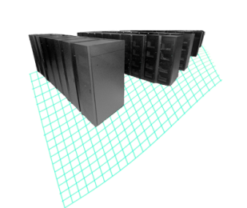
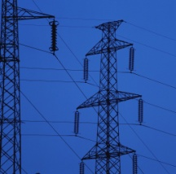

Cloud Computing Paradigm
An IT service delivered to users that provides:
A simple user interface that automatically provisions IT resources
Capacity on demand with massive scalability
Innovative service delivery models for applications
2009
Cloud Computing
1990
Software as a Service
Anytime, anywhere access to resources delivered dynamically as a service
Utility Computing
Network-based subscriptions to applications
Grid Computing
Offering computing resources as a metered service
Solving large problems with parallel computing

Slide 24
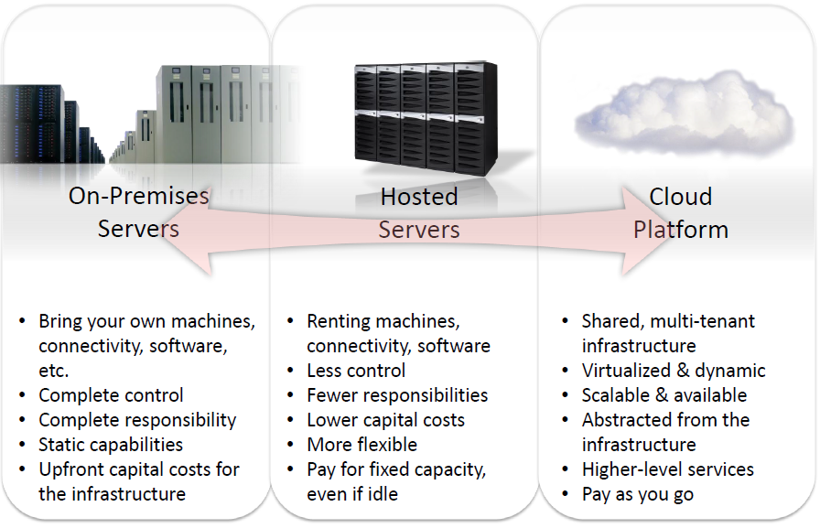
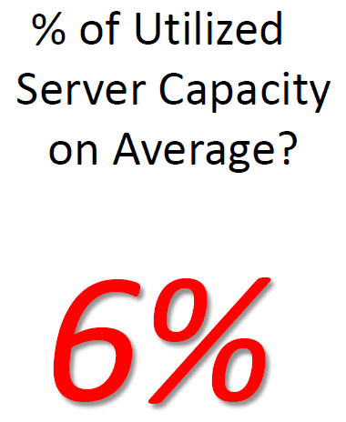
What is a difference?
Typical IT budget :
SW: 35%
HW: 60%
Other: 5%

Slide 25
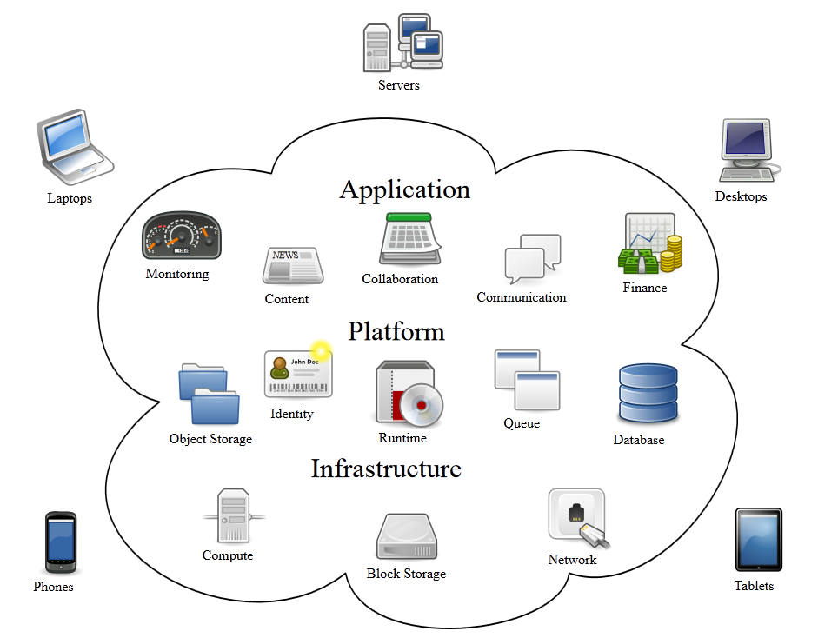
Cloud Computing Principles
Resource Pooling (servers, storage, networks, system environment, services)
On-demand Self Service
Broad Network Access
Rapid Elasticity
Pay-as-you-Go
Cloud Mathematics:
1: Single integrated environment (a collection pool of resources and services)
0: Zero management (automatic management and resilience of resource or service up/down/fail)
∞: Endless possibility (Scalability, Availability, Accessibility, Manageability, Performance)

Slide 26
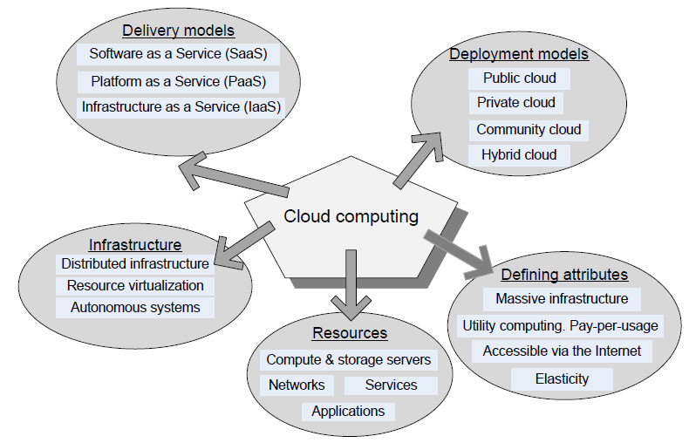
Cloud Computing. Summary

